Slide 1

A-IoT : Work Package: Cabin Air Quality Monitoring
IISc Team
Indian Institute of Science, Bangalore

Slide 2
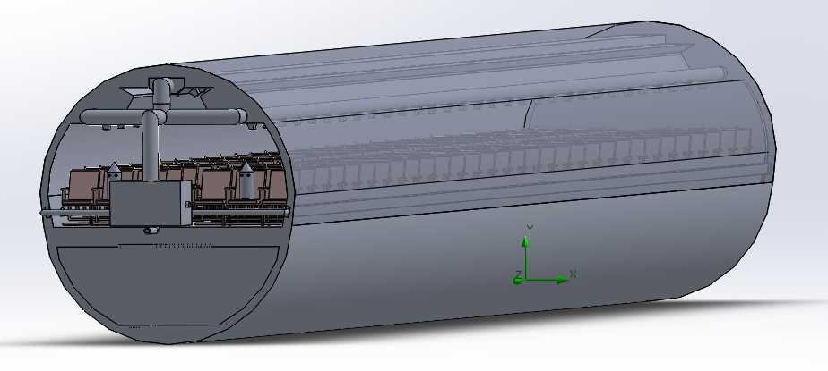
Possible control action implementation
INPUT
(From data generation Model)
CO2, Ozone, PM
Intelligent Fast-loop Algos
Decision for control action
Output
Y
Digital Controller
N
Actuator :
Modify ECS parameters
ECS
Cabin & ECS Status

Slide 3
Factors affecting ECS
Bleed Air ratio:
It’s change affects the relative humidity and ozone level in the cabin, can act as a parameter .
Flowrate / Ventilation Efficiency:
Change in the flow rate/ Ventilation Efficiency will affect the Relative humidity levels inside the cabin.
Cabin pressure will be effected due to variation in the Flowrate/Ventilation Efficiency.
Passenger aircraft cabin air quality: trends, effects, societal costs, proposals.
M.B. Hocking *, Department of Chemistry, University of Victoria, P.O. Box 3065 STN CSC, Victoria, BC, Canada V8W 3V6. Received 27 September 1999; ac0cepted 3 November 1999

Slide 4
Factors considered for closed loop control action
Possible root cause for abnormal CO2 build up inside cabin, to implement closed loop control action :
Change in ventilation.
Ratio of Fresh/cabin air mixture
CO2 concentration in bleed air due to external environment.

Slide 5
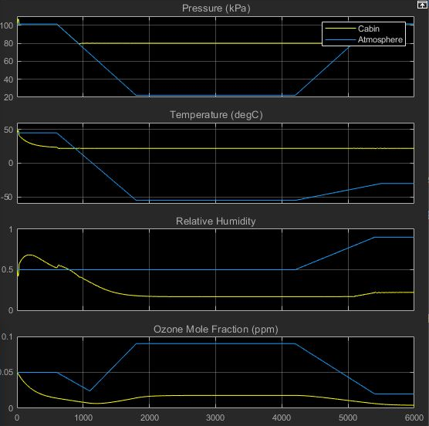
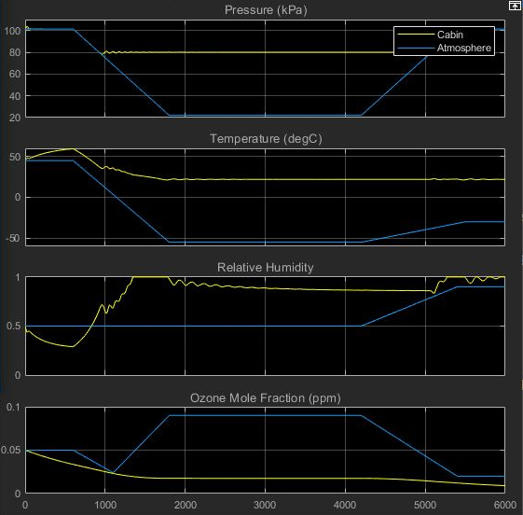
Change in cabin parameters due to variation in flow rate
Scale,
X-axis:
1 unit = 1000 seconds
Y-axis :
1 unit = 1 units of signal
Signals
Time (Seconds)
Fig. ECS parameter for Normal ventilation efficiency inside cabin
Fig. ECS parameter for Anomalous ventilation efficiency inside cabin

Slide 6
Simulation with ECS
2018
2019
GUI Simulate
GUI Simulate
Parameters Updating
( Flow rate, Ozone removal Efficiency, Pax)
ECS
CO₂ & PM Equations
ECS
Data Generated
CO₂ & PM Equations
Data generated for each time sample
TICKStack automation
Input Intelligent aggregator
Controller
Controller Output

Slide 7
Data generation architecture with Neural Network and Controller.
Data generation model
GUI
Fr,X
Suffocation model for CO2
ECS Simulink model (TPH)
Passenger Count.
Anomalous conditions
Fr
Flowrate(Fr),
Bleed- Recirculated Air ratio(X)
Humidity, Temperature, Pressure
Passenger count
Set point
CO2[1:6]
Controller
Neural network(detect root cause)
Anomaly class

Slide 8
Neural Network augmented Control system
Temperature | Pressure | Humidity | Passenger Count | CO₂ across zones | Rate of rise of CO2 | Deviation of zone from mean | No anomaly | VE (flow rate) | Due To Independent Source | Due To Bleed | Class
T_{a} | P_{a} | H_{a} | N_{a} | CO₂[1:6] | dCO₂[1:6] | _{CO2[1:6]} _{- mean(CO2)} | ✓ | ✗ | ✗ | ✗ | 0
T_{b} | P_{b} | H_{b} | N_{b} | CO₂[1:6] | dCO₂[1:6] | _{CO2[1:6]} _{- mean(CO2)} | ✗ | ✓ | ✗ | ✗ | 1
T_{c} | P_{c} | H_{c} | N_{c} | CO₂[1:6] | dCO₂[1:6] | _{CO2[1:6]} _{- mean(CO2)} | ✗ | ✗ | ✓ | ✗ | 2
T_{d} | P_{d} | H_{d} | N_{d} | CO₂[1:6] | dCO₂[1:6] | _{CO2[1:6]} _{- mean(CO2)} | ✗ | ✗ | ✗ | ✓ | 3
Input parameters for the neural network
Output of the NN
The Neural Network is trained with data for different kinds of anomalies.
The Neural Network generates an output which is understood by the controller and a suitable control action is taken.

Slide 9

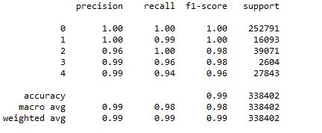
Neural Network augmented Control system
Class0 Class1 Class2 Class3 Class4
Confusion Matrix
Model Evaluation Matrix

Slide 10
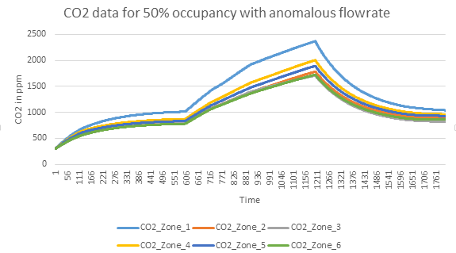
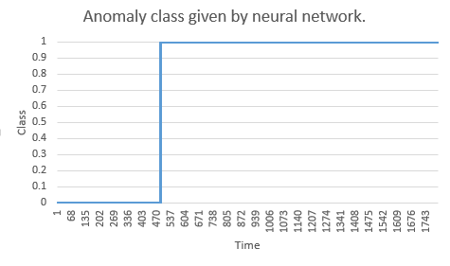
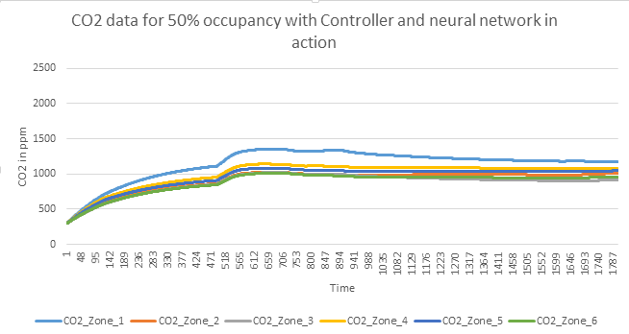
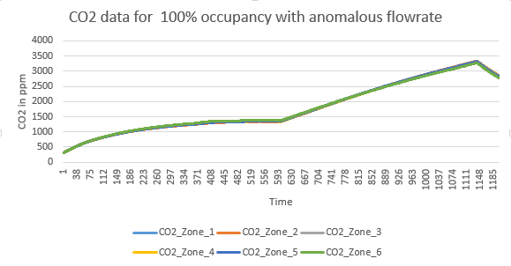
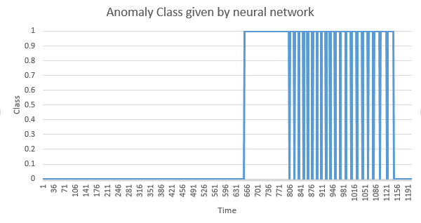
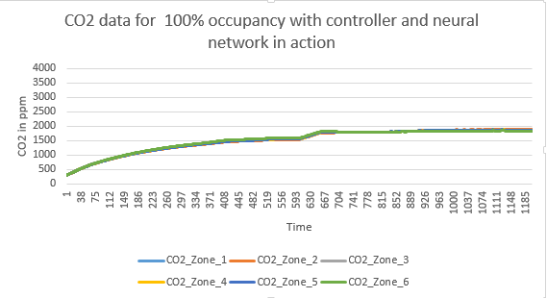
Preliminary Results from neural network.
50% occupancy with Class 1 anomaly
100% occupancy with Class 1 anomaly

Slide 11
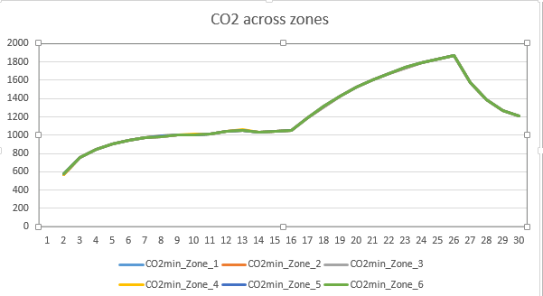
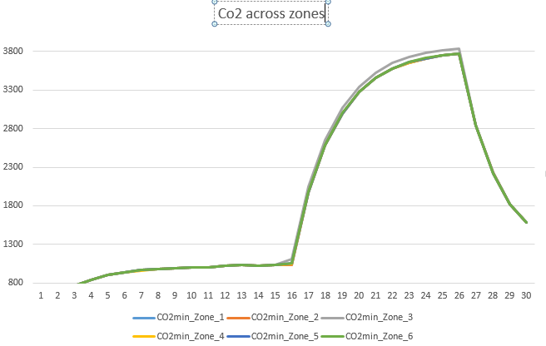
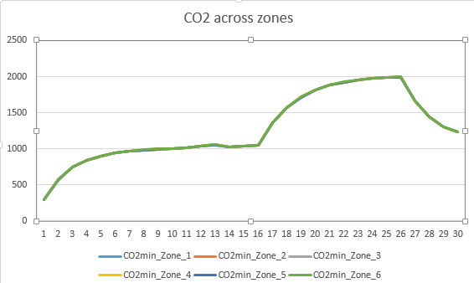
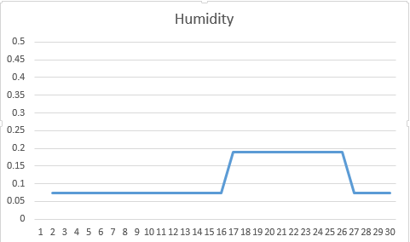
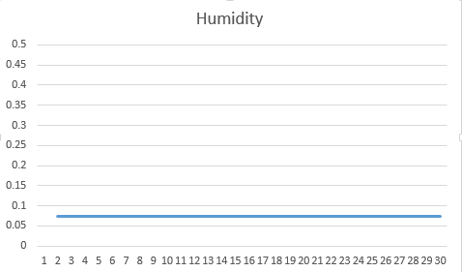
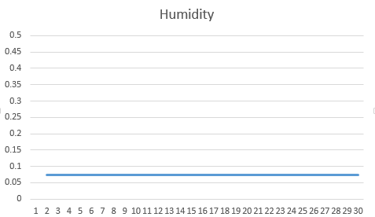
Data set with different anomalous conditions
Class 1- Ventilation efficiency
Class 2 – Independent CO2 source
Class 3 – CO2 from bleed
Scale : Y axis – CO2 inppm. X axis- time in minutes
Scale : Y axis – RH (ratio). X axis- time in minutes

Slide 12
Control actions to be implemented for various classes of anomalies
Class 1
Caused due to poor ventilation.
To be mitigated by increasing Flowrate.
Class 2
Caused due to independent source
To be mitigated by reducing recirculated air.
Class 3
Caused by fuming events from bleed.
To be mitigated by reducing bleed .

Slide 13
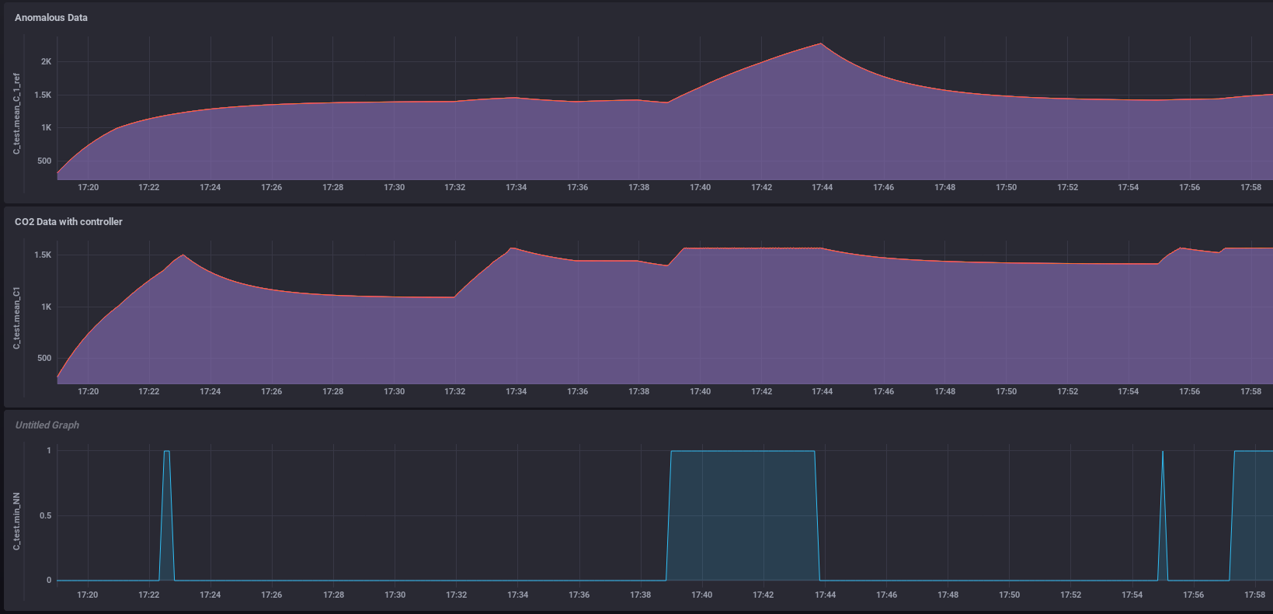
Results: Class 1 anomaly
For 75% occupancy, without controller and neural network, CO2 levels rise upto 2300 ppm.
With Controller levels restricted to 1500 ppm

Slide 14
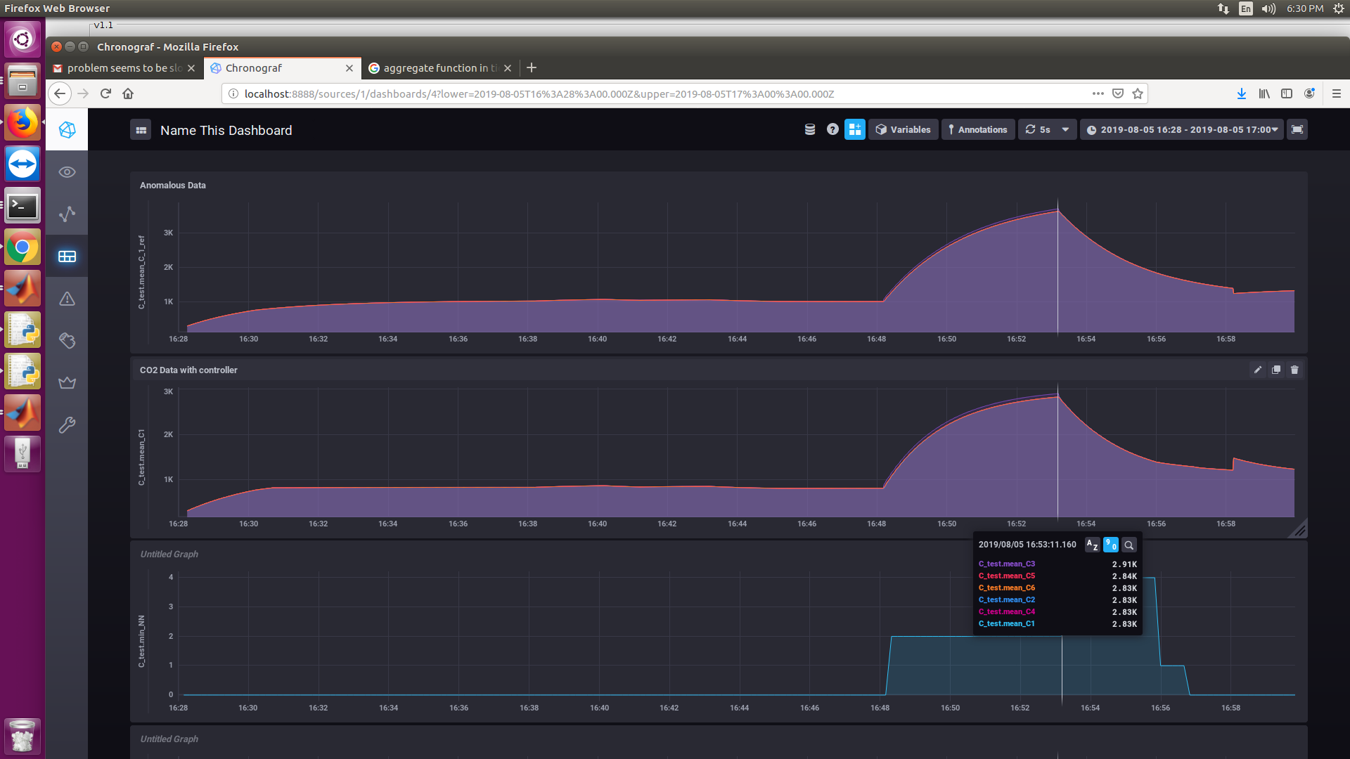
Class 2 anomaly
For 50% occupancy, without controller and neural network, CO2 levels rise upto 3700 ppm.
With Controller levels restricted to 2900 ppm where bleed & recirculation ratio reduced to 0.7

Slide 15
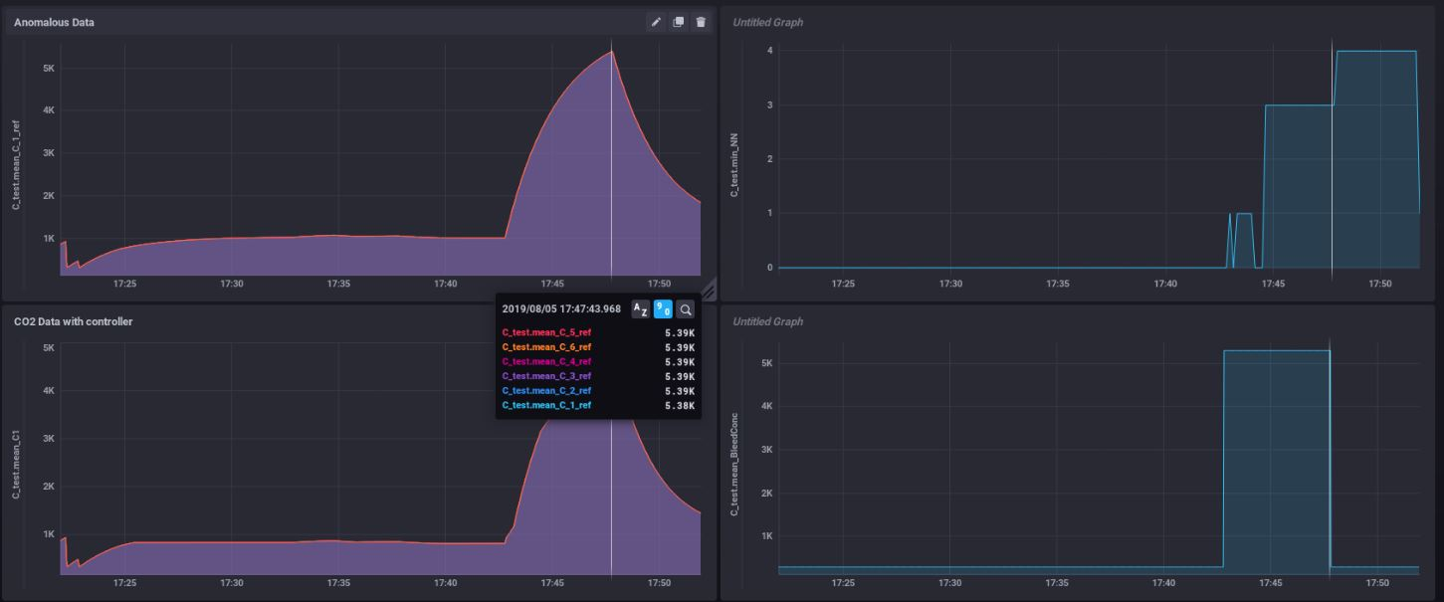
Class 3 anomaly
For 50% occupancy, without controller and neural network, CO2 levels rise upto 5400 ppm.
With Controller levels restricted to 4840 ppm and bleed: recirculation ratio of 0.2

Slide 16
Work done:
Generation and labelling datasets for different classes of anomalies.
Training Neural nets for individual anomalies.
Training the neural net using the complete dataset.
Linking the data generation model with the neural net and controller for real time anomaly detection and control.
Closing the loop by control action implementation and visualisations by integrating TICK stack.
Tasks underway:
Optimizing neural network

Slide 17
Thank you
LOOKING FORWARD FOR YOUR SUPPORT

